Slide 1

TRIANGLE
COUNTING
ALGORITHMS
Charatzoglou Michalis
Georgilas Stelios

Slide 2
Presentation Summary
We will analyze:
The graphs used
Operation and results of exact algorithms
Operation and results of Doulion algorithm
Operation and results of Triest algorithm

Slide 3
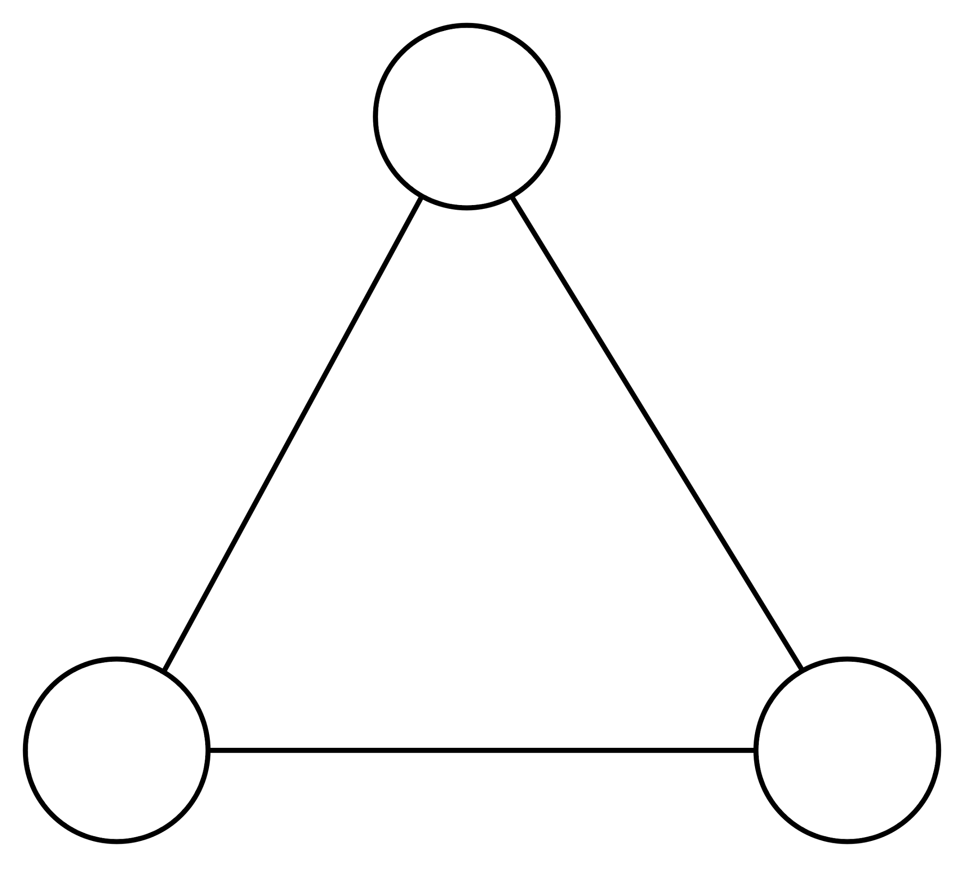
Triangle Theorem
For there to be a triangle between nodes A-B-C:
A
1. Edge A-B must exist
2. Edge B-C must exist
3. Edge C-A must exist
B
C

Slide 4
Graphs
Graph | Name | Edges | Nodes | Triangles | Density
G1 | Facebook | 88234 | 4039 | 1612010 | 0.01
G2 | Condensed Matter Collaboration Network | 93497 | 23133 | 173361 | 0.0003
G3 | Amazon Product Co-purchasing Network | 925872 | 334863 | 667129 | 0.000016
G4 | California Road Network | 2766607 | 1965206 | 120676 | 0.0000014

Slide 5
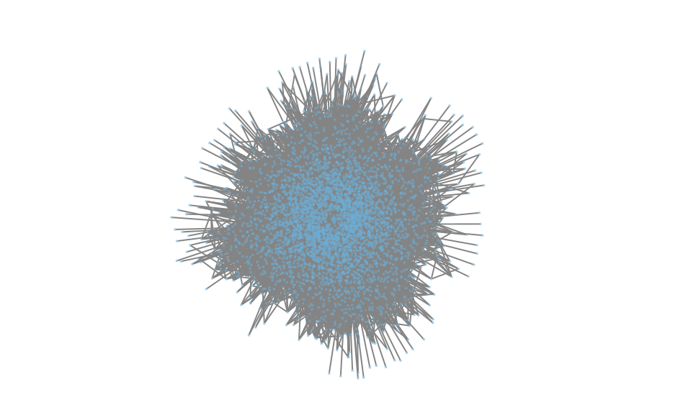
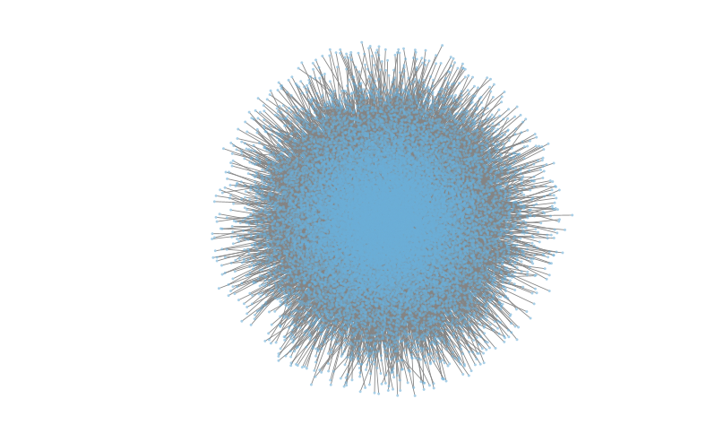
Graphs
G2
G1

Slide 6
Exact Algorithms
The exact algorithms we will analyze are:
1. All Triplets (Brute-Force)
2. Node Iterator
3. Compact Forward

Slide 7
All Triplets (Brute-Force)
Algorithm Description
For each node in the graph, consider it a starting point of a triangle, iterate over its neighbors and consider pairs of neighbors.
For each pair of neighbors, check if there is an edge between them. If there is, increase the triangles counter.
Repeat the process for all nodes.
Divide triangles counter by 6 to avoid overcounting.

Slide 8
Node Iterator
Algorithm Description
For each node in the graph, consider pairs of its neighbors.
Check if the pair of neighbors forms an edge, indicating a triangle.
Divide triangles counter by 3 to avoid overcounting.

Slide 9
Compact Forward
Algorithm Description
Prioritize nodes based on their degrees.
For each node, consider neighbors with higher degrees.
Compare the degrees of neighbors to identify triangles efficiently.
It is designed to exploit the graph’s degree structure to efficiently identify triangles, making it a more optimized approach compared to brute-force algorithms.

Slide 10
Algorithms Comparison
Graph | Node Iterator | Compact Forward
G1 | 26.4 sec. | 10.2 sec.
G2 | 2.3 sec. | 2.4 sec.
G3 | 13.5 sec. | 20.3 sec.
G4 | 8.4 sec. | 39.6 sec.

Slide 11
Doulion
Algorithm Description
Loops over different sparsity levels (0.1, 0.3, 0.5, 0.7, 0.9) and decides whether to include each edge based on given probability.
For each sparsity level, conducts 10 experiments, running CF and NI on the sparsified graph.
Computes average accuracy, rel.error, and calculates speedup values for CF and NI.

Slide 12
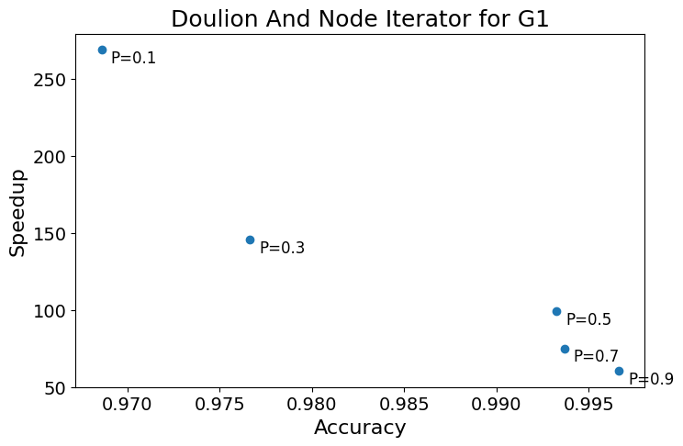
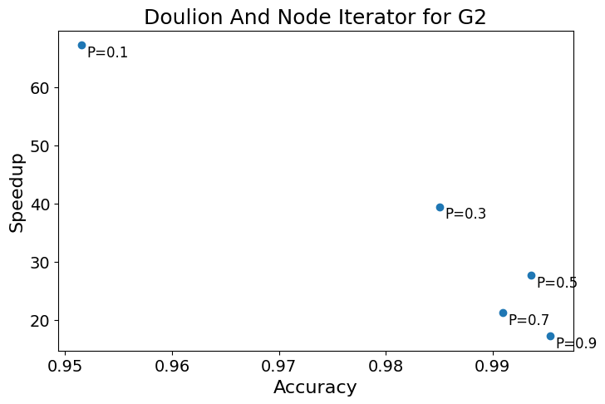
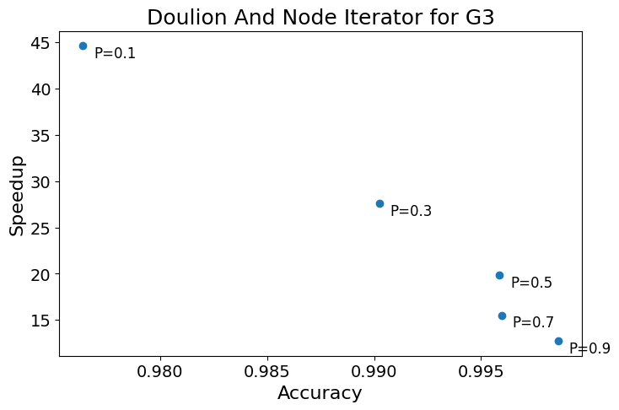
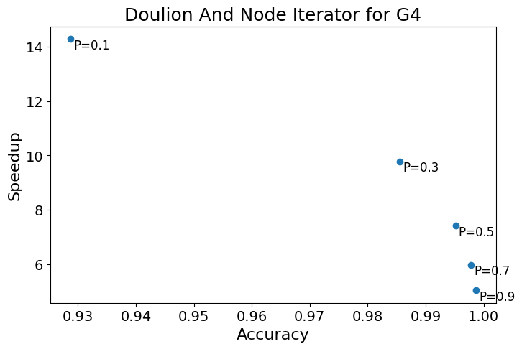
Doulion and Node Iterator

Slide 13
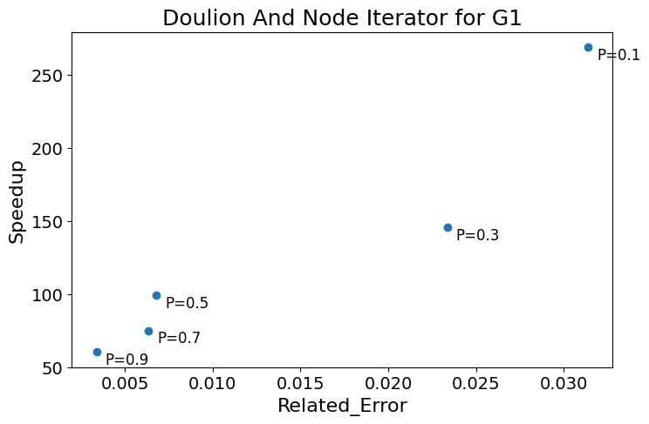
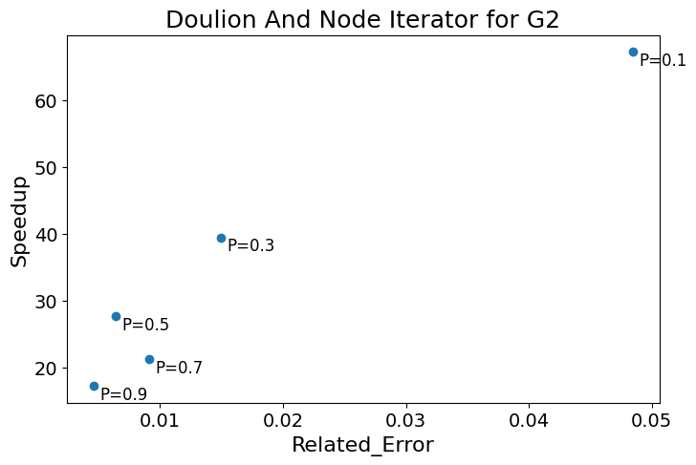
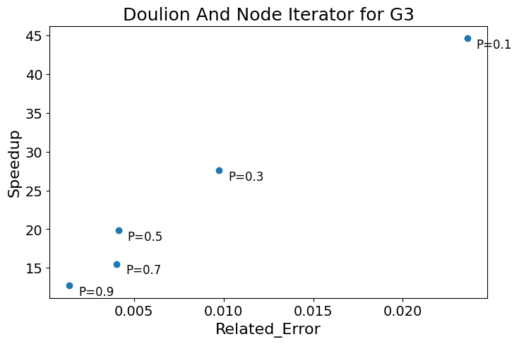
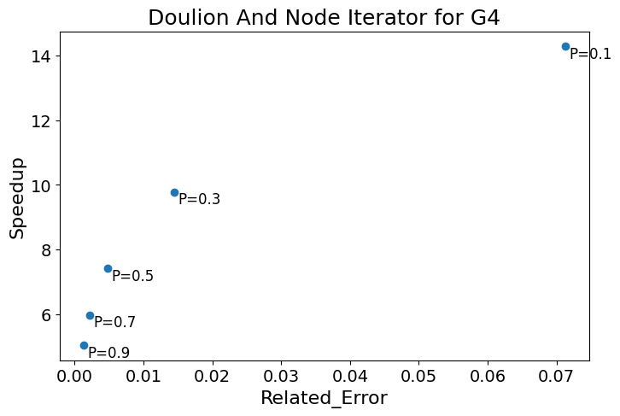
Doulion and Node Iterator

Slide 14
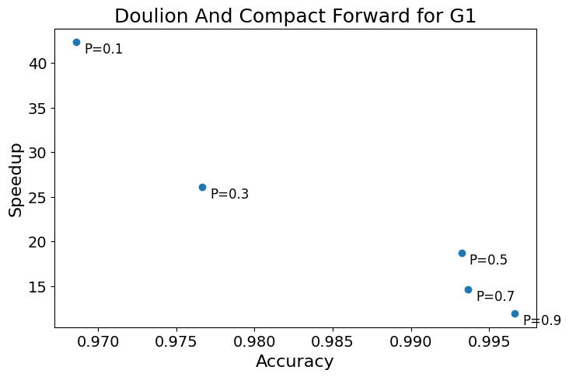
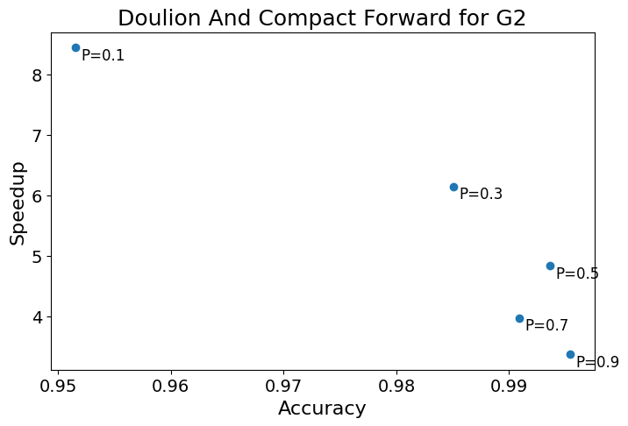
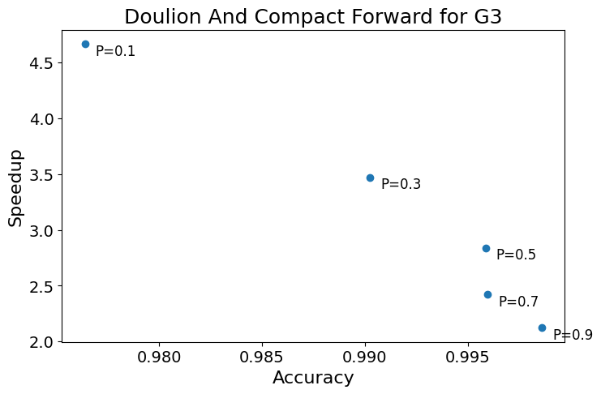
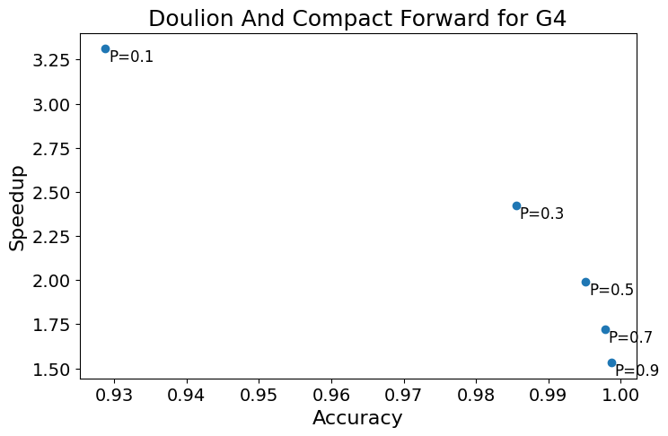
Doulion and Compact Forward

Slide 15
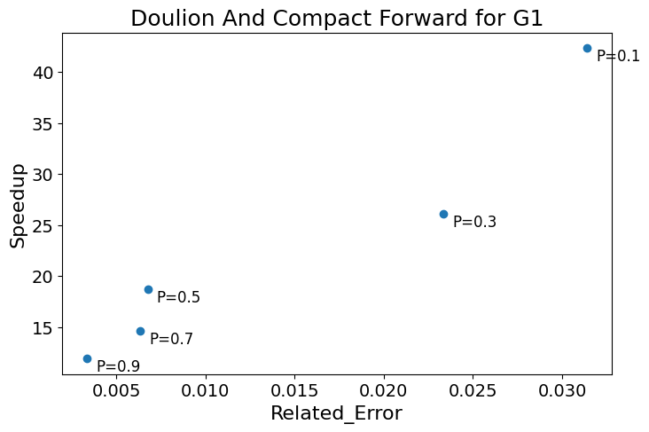
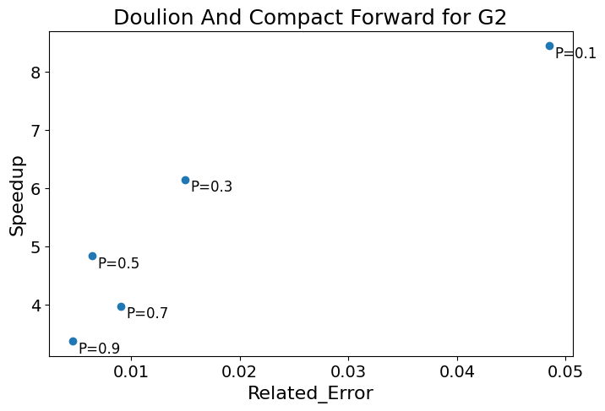
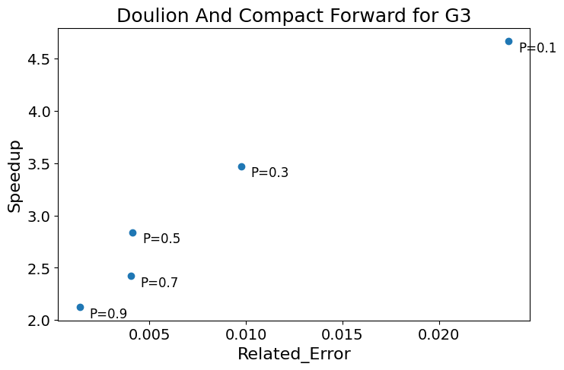
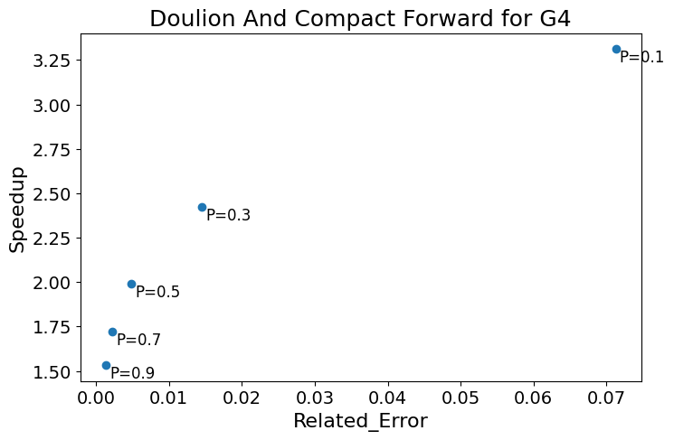
Doulion and Compact Forward

Slide 16
Triest
Algorithm Description
Read edges from the input file one by one.
For each new edge (u,v) update global and local counters based on common neighbors. For each common neighbor w, update counters with probability M/t.
For each edge (u,v) sample it into the graph with probability M/t.
Repeat for different M values.

Slide 17
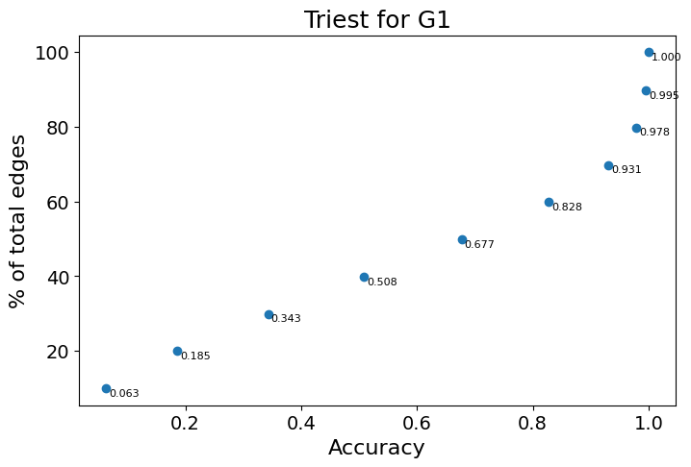
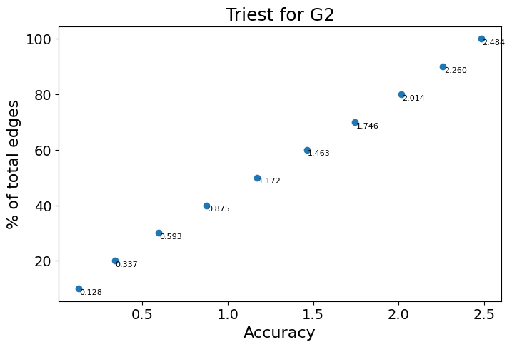
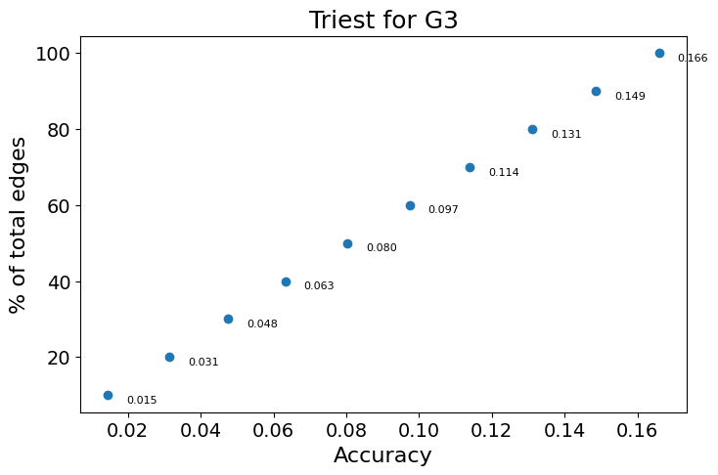
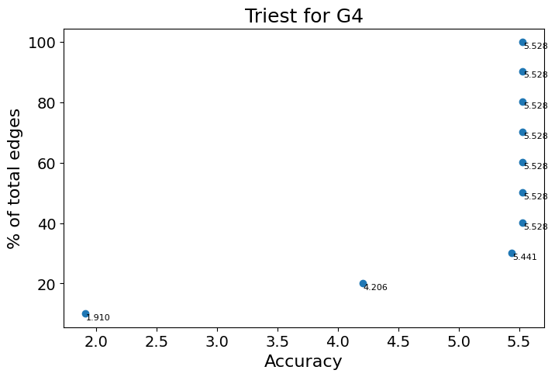
Triest

Slide 18
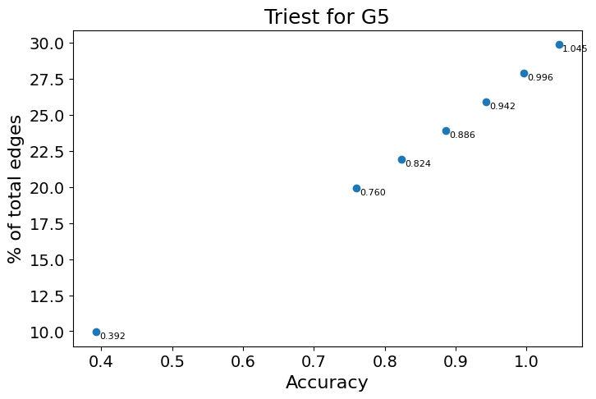
Triest

Slide 19
Triest
Advantages
Scalability: It is designed to handle large-scale graphs, making it a suitable choice for scenarios where the graph cannot be fully loaded into memory.
Feasibility: If other triangle counting algorithms are not practical due to the size of the graph, Triest provides a viable alternative for obtaining an estimate.

Slide 20
Triest
Considerations
Sensitivity to M: While increasing M can improve accuracy, it is important to note that performance can be sensitive to the choice.
Sampling Variability: Triest relies on random sampling, introducing variability in the estimates.
Edge Density: The accuracy of Triest can be influenced by the edge density of the graph. If the graph has low edge density, the estimates may be less accurate.

Slide 21
Thank you.
Any questions?

